Slide 1
FALL DATA CHALLENGE:
Get Out and Vote!
Ran Liao & Zedong Wu
2020.11.9

Slide 2
In this data challenge, we examine several data-driven questions that are related to social issues like racial justice and gender inequality in the American society. Our analysis focused on showing the voting participation percentage across all races/genders, states, the common reasons for people in the least-participated race and the races with the largest population to not vote, and the voting methods across states. We hope that our analysis will generate meaningful implication for the future and provide directions for changes to be made.

Slide 3
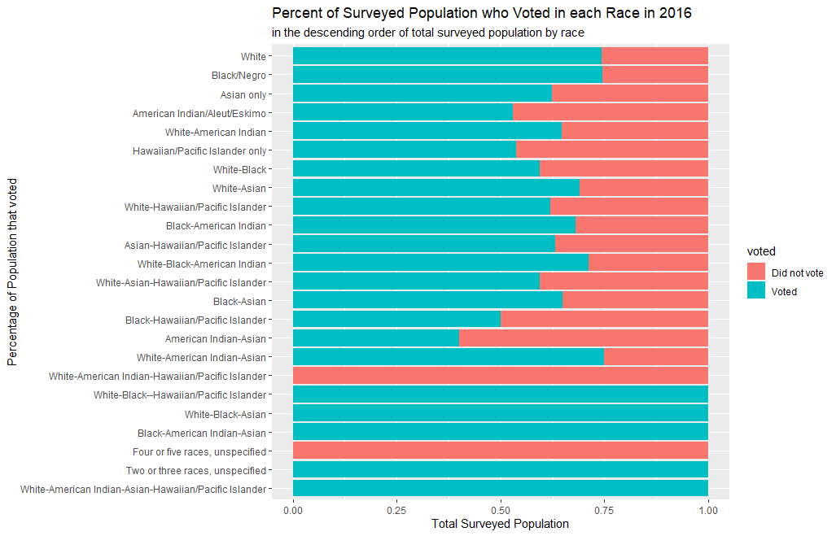
Single Races Participated More
The races that have the largest population (White, Black, Asian) have over half of their population in the dataset voted. Specifically, White and Black have a much higher voter turnout than Asian. However, nearly one third of white and black population and half of the Asian population did not vote. This indicates that there still is a large number of voters who did not participate in the country’s democracy.

Slide 4
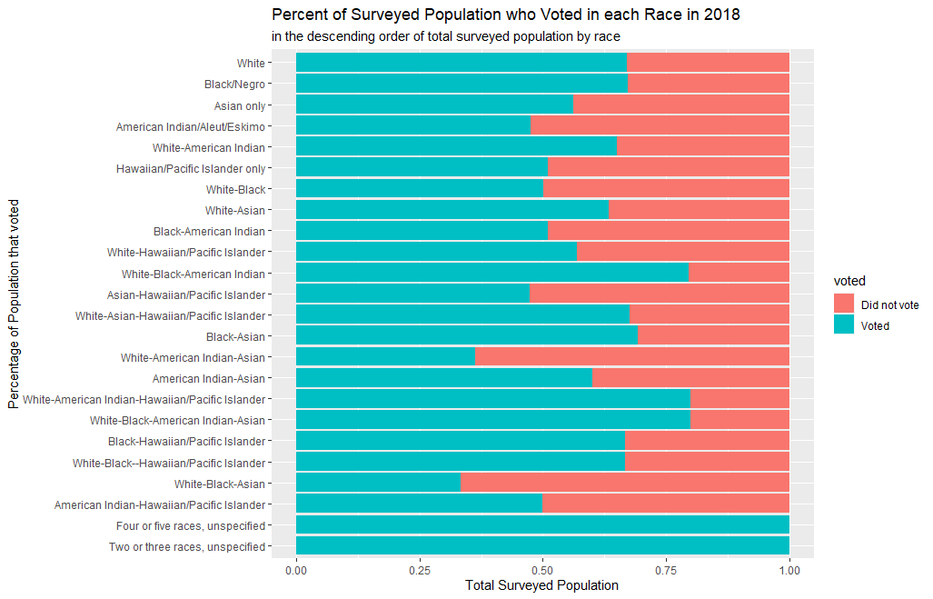
Multi-race Population Involved More
Looking at the 2016 and 2018 vote turnout by race, there is not much increase in terms of the participation rate for majority of the races, though it seems that muti-races population start to involve more. We believe there is still great potential for the voting participation percentage to rise significantly in the future, as we will talk about more in later analysis.

Slide 5
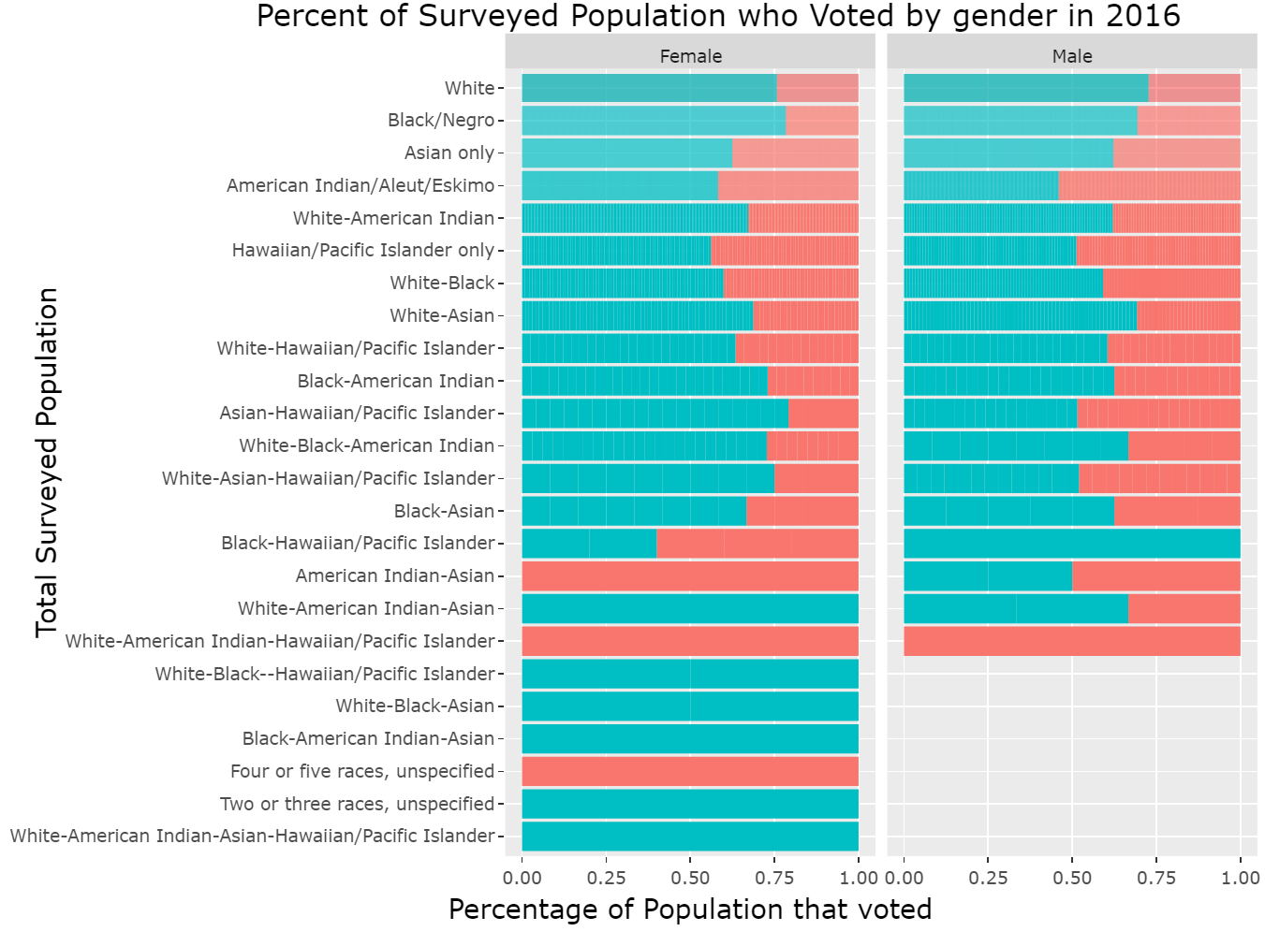
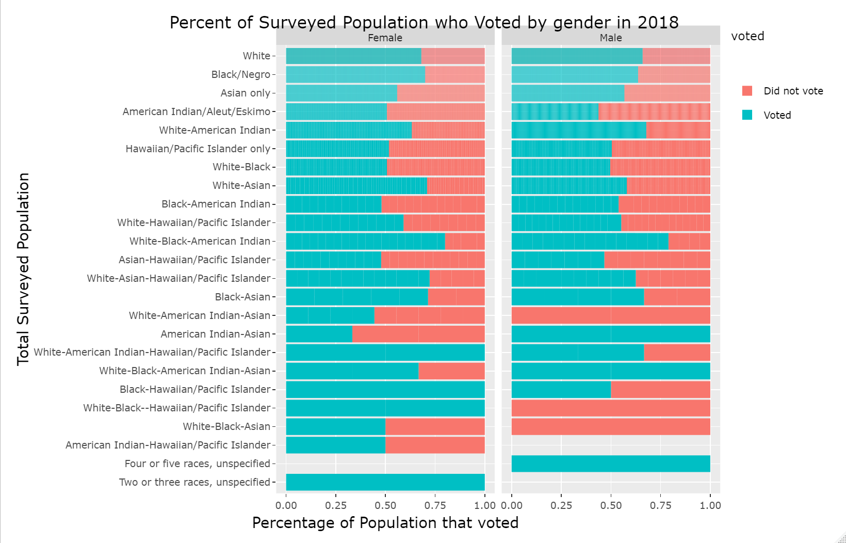
Trend of Sexual Equality
When dividing the results by gender, we did not find a significant difference in voter turnout across gender, which could indicate that both genders now have equal right to participate in the country’s democracy, and is a great progress we have made.

Slide 6
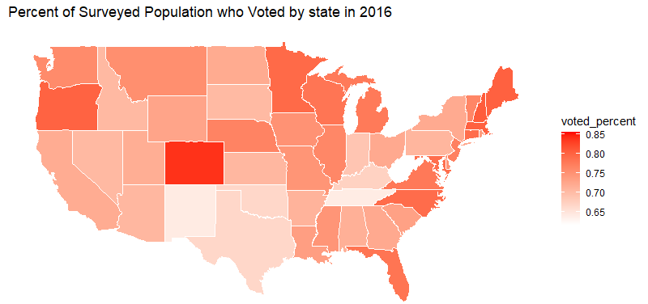
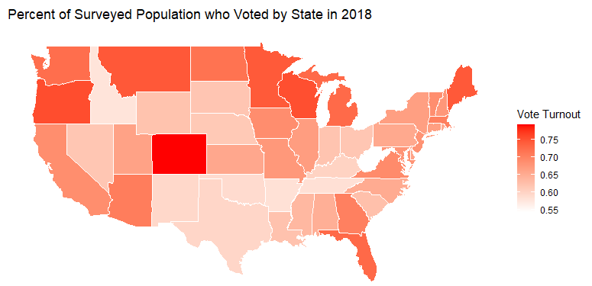
Vote Turnout State Wide
Economics and political situations vary across states and they could potentially impact the voter turnout. From the map, the state of Colorado has the highest voter turnout, and states on the east and west coast tend to have a much higher turnout than those in the south, central America and midwest. The state of Arizona, Texas, and those in the midwest often are the toss-up states that eventually decide the election results, yet their voter turnouts are relatively lower as shown by the data. Encouraging more voters in these areas to vote can potentially affect the election results

Slide 7
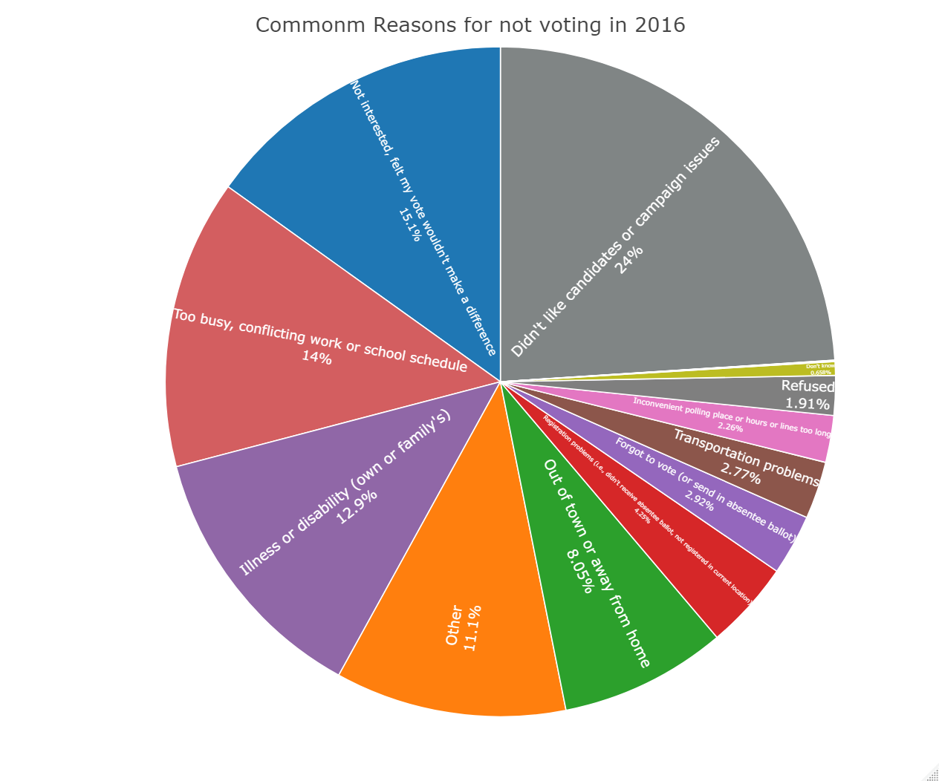
Common Reasons for NOT Voting
Having known that there still is a large population who did not vote, we wanted to find out the common reasons for them to do so. Reasons like “didn’t like candidates or campaign issues” and “not interested, felt my vote won’t make a difference” are the top two reasons among all races. This could imply important changes to make in the future campaigns, like having the candidates discussing more relevant issues, having the voters’ voice heard even when selecting who should be the candidates, and more education on long term impact of voting for everyone, to make more people participate. (similar in 2018)

Slide 8
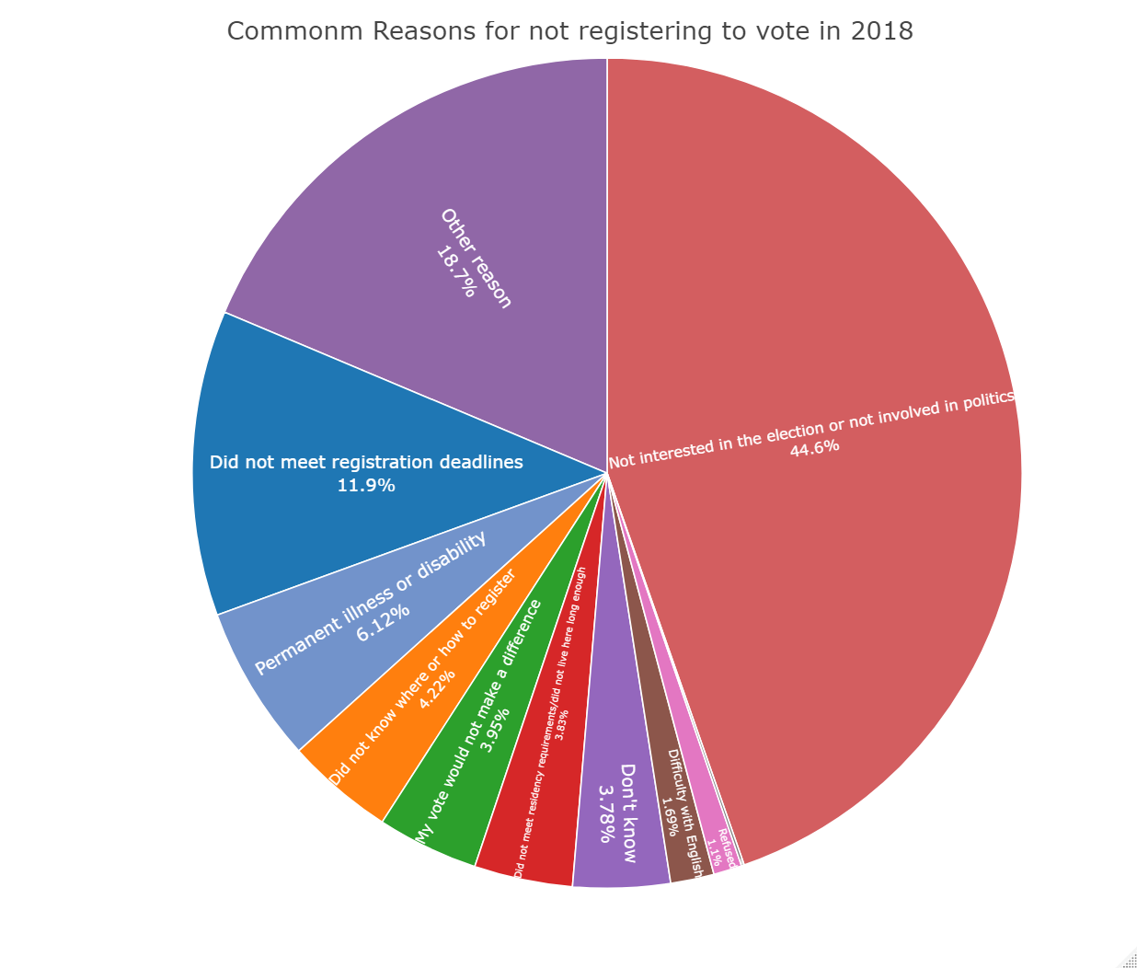
Common Reasons for NOT Registered to Vote
We then analyzed what are the most common reasons for people to not register at all. We discover that “not interested in the election or not involved in politics” and “did not meet registration deadlines” are the top two. Over half of people did not vote because of these reasons and reflecting on them, we can make changes such as promoting the education of the political impact people can make starting at the young age, and having stronger publicity of the recent political events, especially at school and company, so that people can be in greater exposure of what is going on in the political world, which will help more to be involved. (similar in 2016)

Slide 9
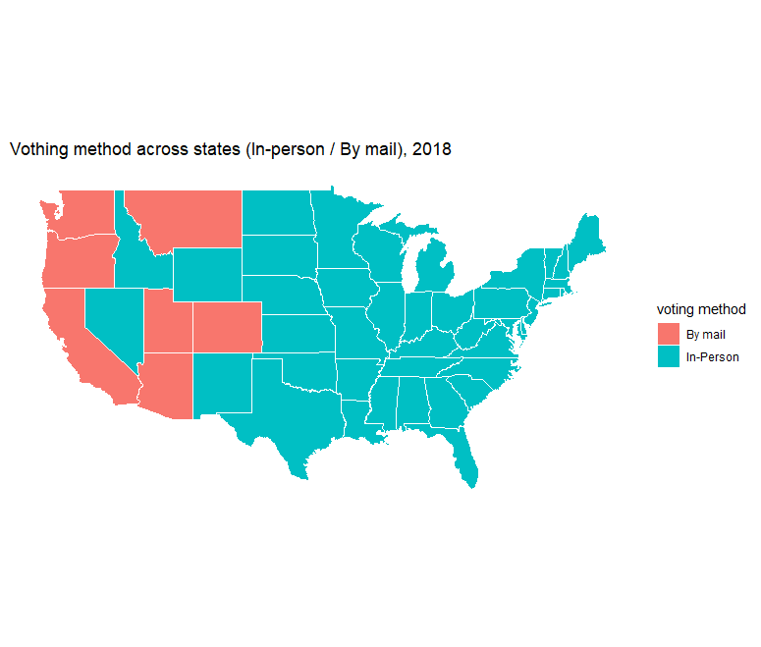
Voting Method Preference by State
Because of Covid-19, we have seen a great number of mail-in ballots in the 2020 election, which is a controversial voting method that some have suspected as a source of voter fraud. Thus, we analyzed the voting methods in the past across states. In 2016 and 2018, there was already a large number of voters who voted by mail and in seven states including Washington, Oregon and California, the number of people who voted by mail surpassed that of those who voted in-person (similar 2016). Based on the result, we can see that voting by mail was already a prevalent voting method four years ago and accusing this method as a source of illegal votes and voter fraud may not stand.

Slide 10
Thanks
Here is the github link where all codes are: https://github.com/TomWuzedong/Fall-Data-Challenge-2020
And link to access all the interactive plots instead of static plots (took long to load) : https://tomwuzedong.github.io/Fall-Data-Challenge-2020/

